Slide 1


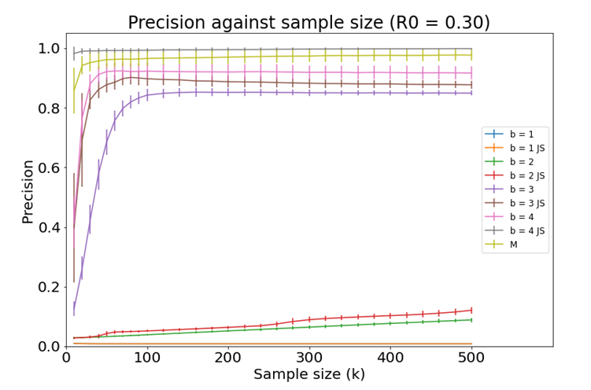
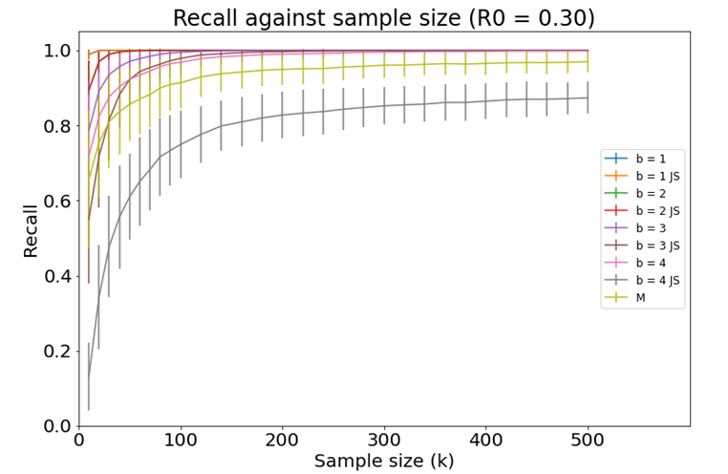
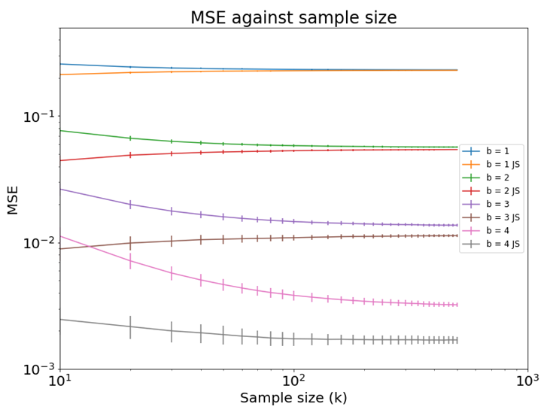
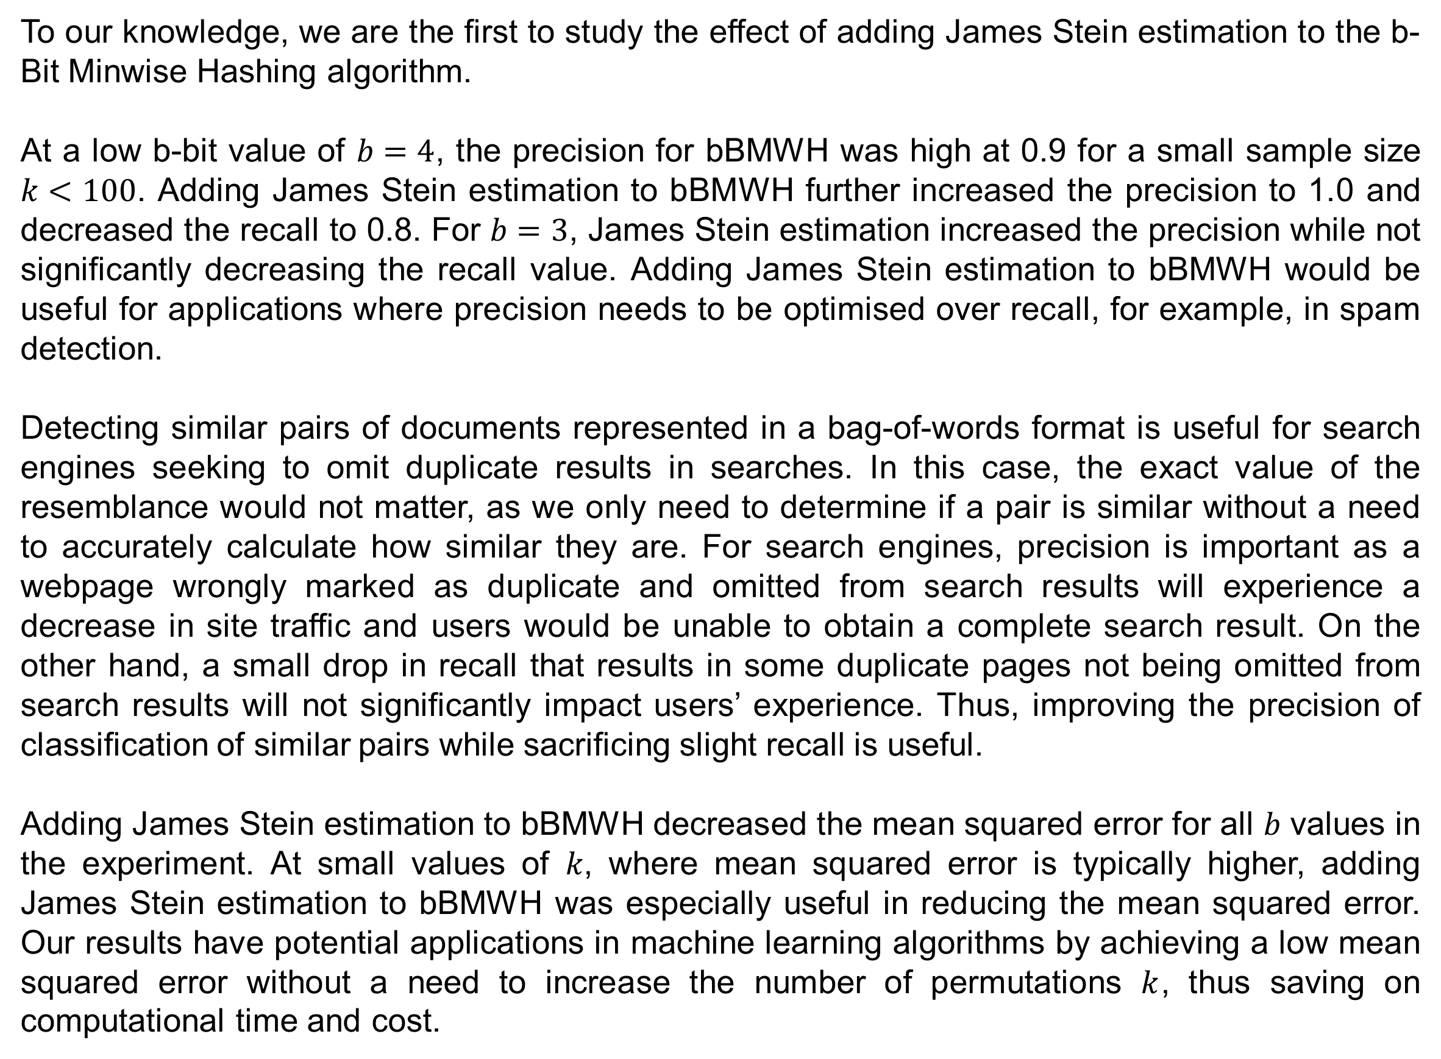



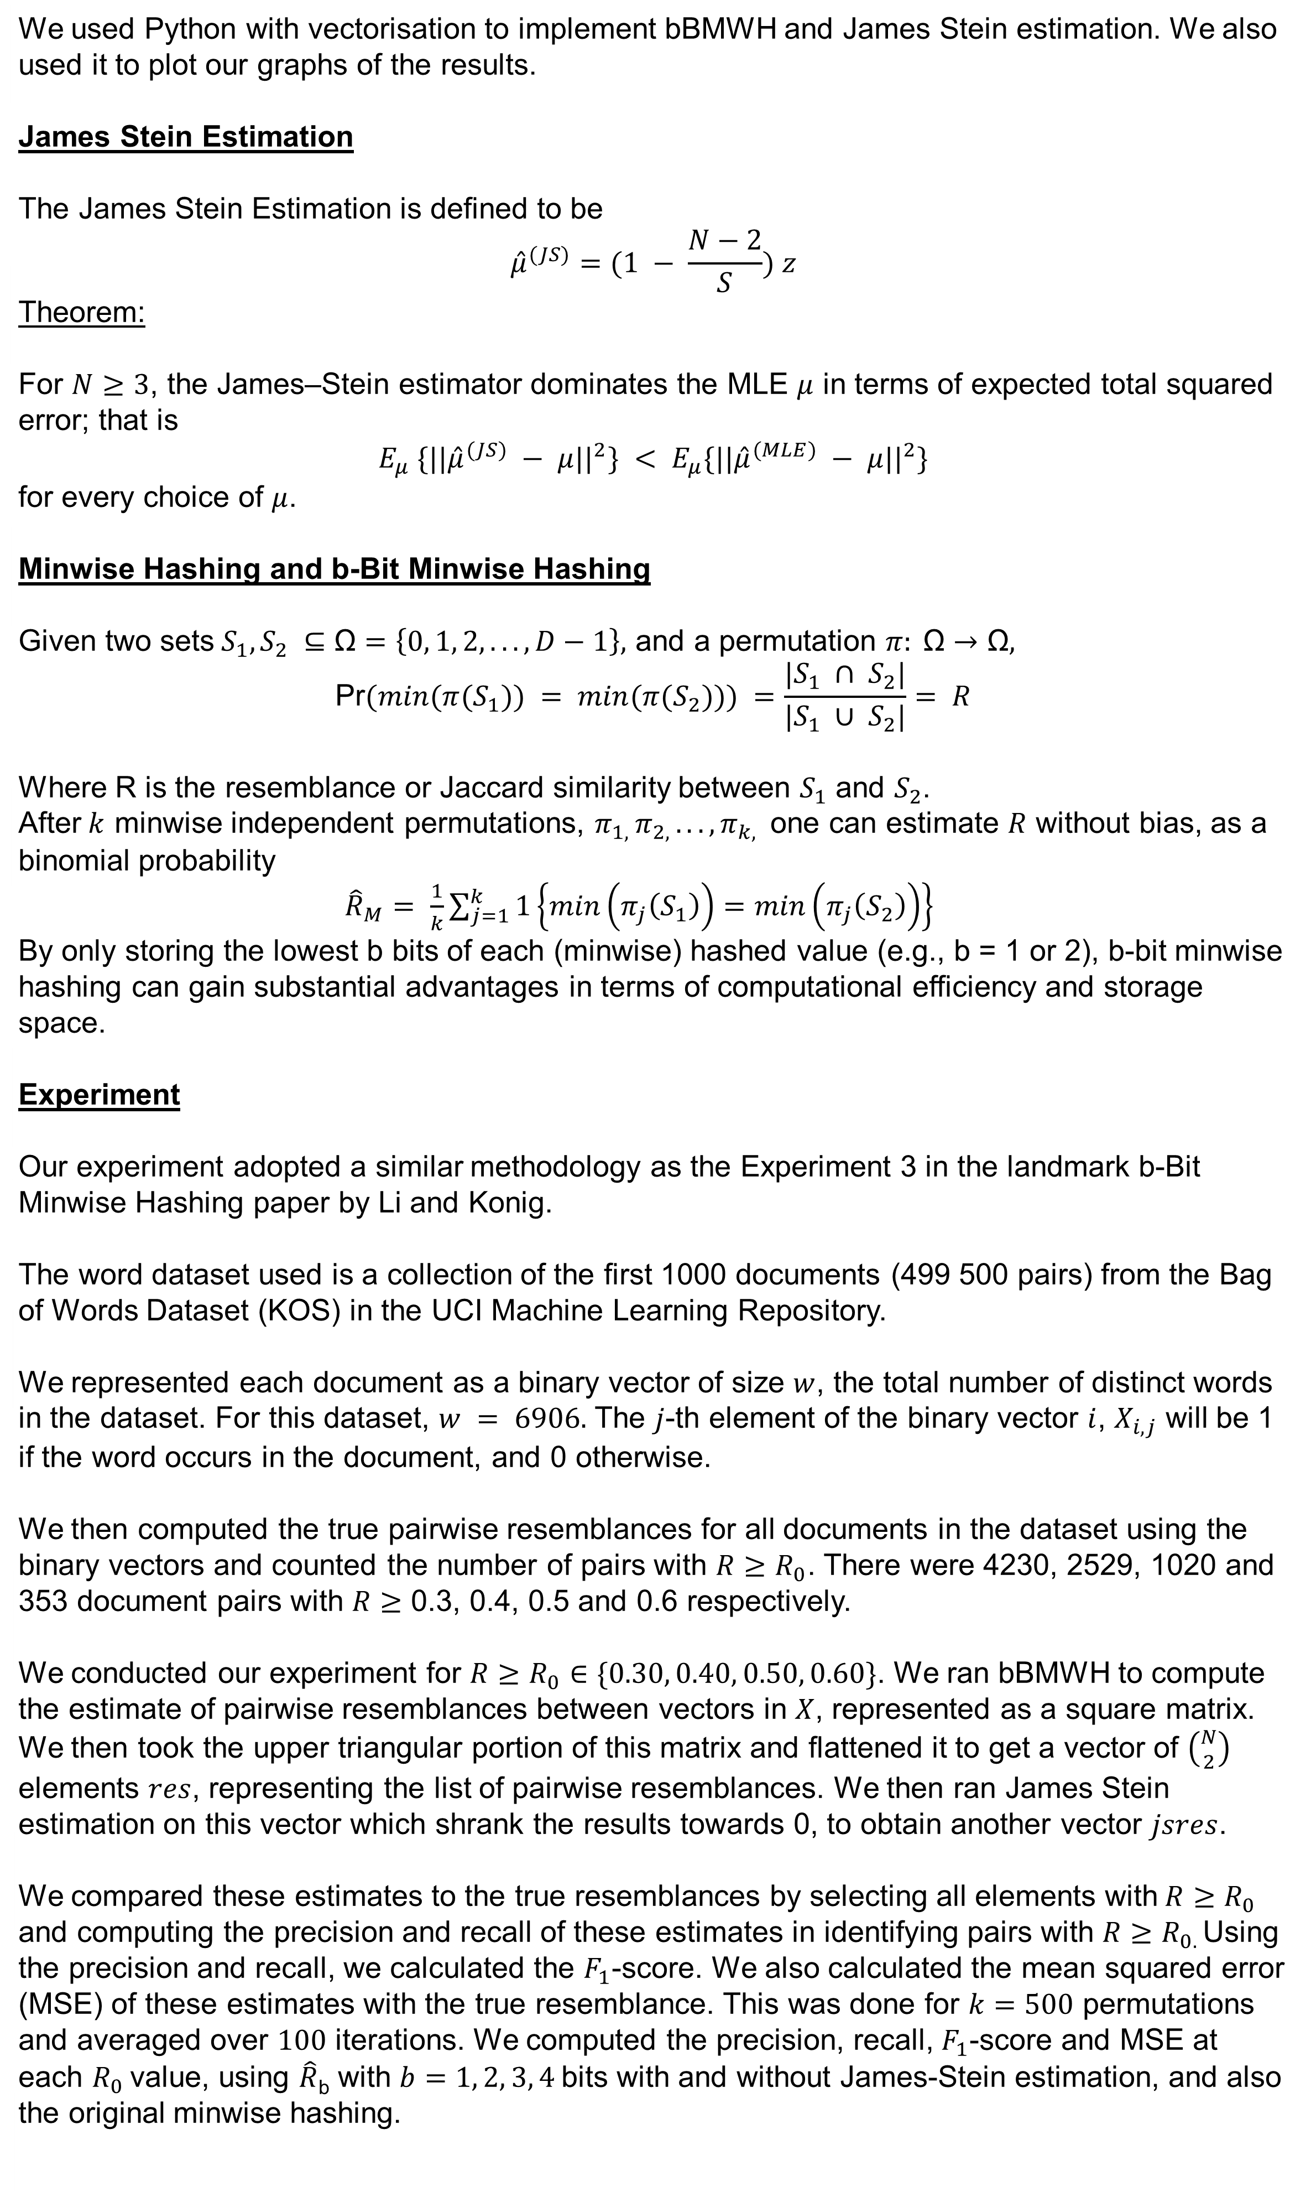

INVESTIGATING JAMES STEIN PARADOX
AND APPLYING JAMES STEIN ESTIMATION TO MACHINE LEARNING PROBLEMS
Toh Jing En Daniel¹, Kan Rui Xian Matthew¹ and Dr Keegan Kang²
¹NUS High School of Mathematics and Science, ²Singapore University of Technology and Design
INTRODUCTION
RESULTS
In traditional statistical theory, no other estimation is uniformly better than the observed average when applied to observations. The paradoxical element in James Stein’s estimation is that it contradicts traditional statistical theory elemental law if there are 3 or more sets of data, even when the 3 sets are completely unrelated. For example, the unrelated datasets of the estimates of the average price of HDB flats in Singapore, the chance of rain in London, and the average height of Americans can be combined to obtain a estimate better than computing the estimates individually in terms of mean squared error. When first proposed, the James Stein estimator seemed counter-intuitive and illogical. However, it has been proven to have lower mean squared error than the traditional maximum likelihood estimator, when there are at least 3 parameters of interest.
Many machine learning applications are faced with very large and high-dimensional datasets. Hashing algorithms such as minwise hashing reduce storage requirements and improve computational efficiency, without compromising on estimation accuracy. b-bit minwise hashing (bBMWH) is a recent progress for efficiently (in both time and space) computing resemblances among extremely high-dimensional binary vectors.
We present some findings for $R_{0}=0.30$ which are more significant here. All experiments were done for $k=500$ permutations and averaged over $100$ iterations.
Precision Recall
Mean Square Error
HYPOTHESIS
For $b≤2$, the precision for both bBMWH and bBMWH combined with James Stein estimation was low at <0.2. This agrees with previous research where using $b=1$ bit per hashed value yields a sufficiently high precision only when $R_{0} ≥ 0.5$.
At $b=3$, the precision for bBMWH increased to 0.8 even for a small $k=100$. Adding James Stein estimation to bBMWH further increased the precision.
At $b=4$, the precision for bBMWH increased to 0.9 for $k<100$. Adding James Stein estimation to bBMWH further increased the precision to near 1.0.
A high recall of >0.9 was obtained for bBMWH alone and bBMWH with James Stein estimation at the lowest bit of $b=1$. The recall values are all very high and do not well differentiate between bBMWH with or without James Stein estimation (except for low values of $k$).
However, when the number of bits was increased to $b=4$, the recall value decreased to 0.8 when James Stein estimation was added. As recall is inversely proportional to precision, an increase in precision with James Stein estimation results in a decrease in recall.
We hypothesized that adding James Stein estimation to bBMWH improves the precision, recall and 𝐹1-score, and decreases the mean square error of the estimate from the hashing algorithm.
MATERIALS AND METHODS
We used Python with vectorisation to implement bBMWH and James Stein estimation. We also used it to plot our graphs of the results.
James Stein Estimation
The James Stein Estimation is defined to be
$${\hat{μ}}^{(JS)}=(1 − \frac{N−2}{S}) z$$
Theorem:
For $N≥3$, the James–Stein estimator dominates the MLE $μ$ in terms of expected total squared error; that is
$$E_{μ} \{||{\hat{μ}}^{(JS)} − μ||^{2}\} < E_{μ}\{||{\hat{μ}}^{(MLE)} − μ||^{2}\}$$
for every choice of $μ$.
Minwise Hashing and b-Bit Minwise Hashing
Given two sets${ S}_{1}, S_{2} ⊆\text{Ω}=\left\{0, 1, 2, ..., D−1\right\},$ and a permutation $π: \text{Ω}→\text{Ω},$
$$\text{Pr}(min(π(S_{1})) = min(π(S_{2}))) =\frac{|S_{1} ∩ S_{2}|}{|S_{1} ∪ S_{2}|}= R$$
Where R is the resemblance or Jaccard similarity between $S_{1}$ and $S_{2}$.
After$k$ minwise independent permutations, $π_{1, }π_{2, }..., π_{k, }$ one can estimate $R$ without bias, as a binomial probability
${\hat{R}}_{M}= \frac{1}{k}\sum_{j=1}^{k}{1}\left\{min\left(π_{j}\left(S_{1}\right)\right)=min\left(π_{j}\left(S_{2}\right)\right)\right\}$
By only storing the lowest b bits of each (minwise) hashed value (e.g., b = 1 or 2), b-bit minwise hashing can gain substantial advantages in terms of computational efficiency and storage space.
Experiment
Our experiment adopted a similar methodology as the Experiment 3 in the landmark b-Bit Minwise Hashing paper by Li and Konig.
The word dataset used is a collection of the first 1000 documents (499 500 pairs) from the Bag of Words Dataset (KOS) in the UCI Machine Learning Repository.
We represented each document as a binary vector of size $w$, the total number of distinct words in the dataset. For this dataset, $w = 6906.$ The $j$-th element of the binary vector $i$, $X_{i,j}$ will be 1 if the word occurs in the document, and 0 otherwise.
We then computed the true pairwise resemblances for all documents in the dataset using the binary vectors and counted the number of pairs with ${R≥R}_{0}$. There were 4230, 2529, 1020 and 353 document pairs with $R≥$ 0.3, 0.4, 0.5 and 0.6 respectively.
We conducted our experiment for ${R≥R}_{0}∈\{0.30, 0.40, 0.50, 0.60\}$. We ran bBMWH to compute the estimate of pairwise resemblances between vectors in $X$, represented as a square matrix. We then took the upper triangular portion of this matrix and flattened it to get a vector of $\left({N \atop 2}\right)$ elements $res$, representing the list of pairwise resemblances. We then ran James Stein estimation on this vector which shrank the results towards 0, to obtain another vector $jsres$.
We compared these estimates to the true resemblances by selecting all elements with${ R≥R}_{0}$ and computing the precision and recall of these estimates in identifying pairs with ${R≥R}_{0. }$Using the precision and recall, we calculated the $F_{1}$-score. We also calculated the mean squared error (MSE) of these estimates with the true resemblance. This was done for $k=500$ permutations and averaged over $100$ iterations. We computed the precision, recall, $F_{1}$-score and MSE at each $R_{0}$ value, using $\hat{R}$_{b} with $b=1, 2, 3, 4$bits with and without James-Stein estimation, and also the original minwise hashing.
MSE is not affected by the threshold value $R_{0}$ chosen and is the same for all $R_{0}$ values.
Adding James Stein estimation to bBMWH decreased the MSE for all b values. At small sample sizes of $k$, where MSE is higher, adding James Stein estimation to bBMWH was especially useful in reducing the MSE as compared to bBMWH alone.
DISCUSSION AND IMPLICATIONS
To our knowledge, we are the first to study the effect of adding James Stein estimation to the b-Bit Minwise Hashing algorithm.
At a low b-bit value of $b=4$, the precision for bBMWH was high at 0.9 for a small sample size $k<100$. Adding James Stein estimation to bBMWH further increased the precision to 1.0 and decreased the recall to 0.8. For $b=3$, James Stein estimation increased the precision while not significantly decreasing the recall value. Adding James Stein estimation to bBMWH would be useful for applications where precision needs to be optimised over recall, for example, in spam detection.
Detecting similar pairs of documents represented in a bag-of-words format is useful for search engines seeking to omit duplicate results in searches. In this case, the exact value of the resemblance would not matter, as we only need to determine if a pair is similar without a need to accurately calculate how similar they are. For search engines, precision is important as a webpage wrongly marked as duplicate and omitted from search results will experience a decrease in site traffic and users would be unable to obtain a complete search result. On the other hand, a small drop in recall that results in some duplicate pages not being omitted from search results will not significantly impact users’ experience. Thus, improving the precision of classification of similar pairs while sacrificing slight recall is useful.
Adding James Stein estimation to bBMWH decreased the mean squared error for all $b$ values in the experiment. At small values of $k$, where mean squared error is typically higher, adding James Stein estimation to bBMWH was especially useful in reducing the mean squared error. Our results have potential applications in machine learning algorithms by achieving a low mean squared error without a need to increase the number of permutations $k$, thus saving on computational time and cost.
ACKNOWLEDGEMENTS
We would like to thank Dr. Keegan Kang for his mentorship and guidance. We would also like to thank our teachers, Mr. Chai Ming Huang and Mr. Lim Teck Choow, for their supervision.

